Slide 1

Long Short-Term Memory (LSTM)
521H0489 – Ho Huu An

Slide 2
Introduction
Hochreiter and Schmidhuber developed the LSTM, a form of RNN.
It solves the problem of long-term dependency in standard RNNs.
Recurrent Neural Network is a type of Neural Network where the output from the previous step is fed as input to the current step.
Type of data: Sequence data
RNNs are good at processing sequence data for predictions.
Speech recognition
Language translation
Stock prediction

Slide 3
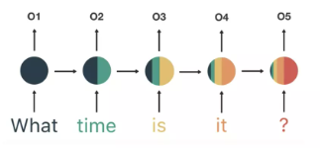
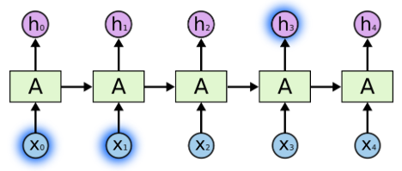
RNN
The sky color is “blue”
RNN operates well because the gap between the prediction "blue" and the required context information "sky" is small.

Slide 4
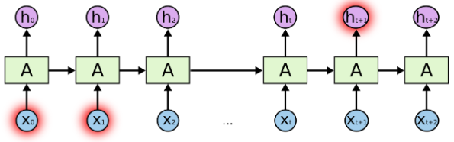
RNN
I live in Sa Pa, Lao Cai … where I live, the weather is generally “cold” most of the year
RNN performs badly when the gap between the Prediction "cold" and the required context information "Sa Pa" is considerable.

Slide 5
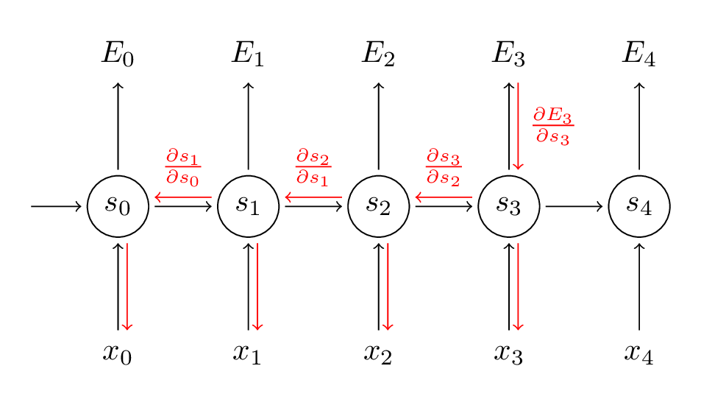
Backpropagation Through Time (BPTT)
RNN
Solves the vanishing gradient problem by enabling gradients to travel back in time without vanishing or exploding.
This allows the network to learn long-term dependencies by efficiently propagating and changing gradients across several time steps.

Slide 6
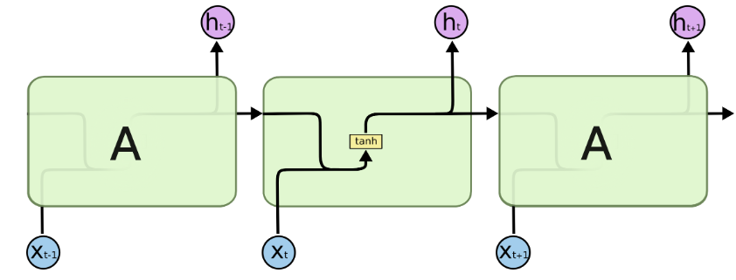
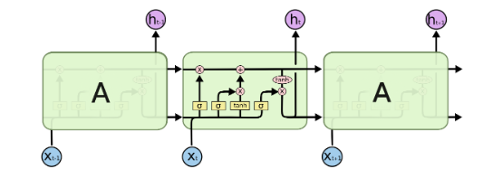
Recurrent Neural Network
Long-Short Term Memory

Slide 7
LSTM
Long-Term Memory
Short-Term Memory
The cell state resembles a conveyor belt. It flows directly down the whole chain, with only a few small linear interactions.
It's incredibly easy for information to just travel down it, unmodified.
LSTMs can remove or add information to the cell's state, which is carefully controlled by structures known as gates.

Slide 8
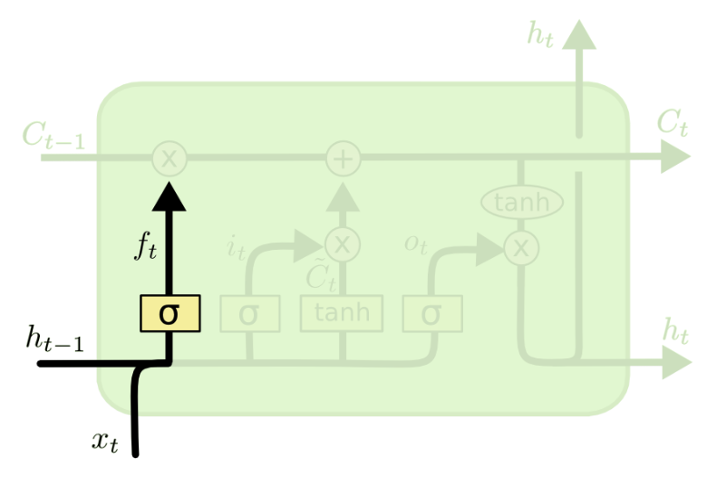
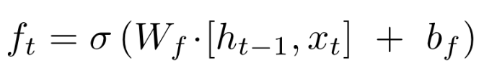
LSTM
Forget gate layer:
Decide what information throw away the cell state.
the current input + the output from the previous time step => should be forgotten
Output a number ranges from 0 to 1.
Step1

Slide 9
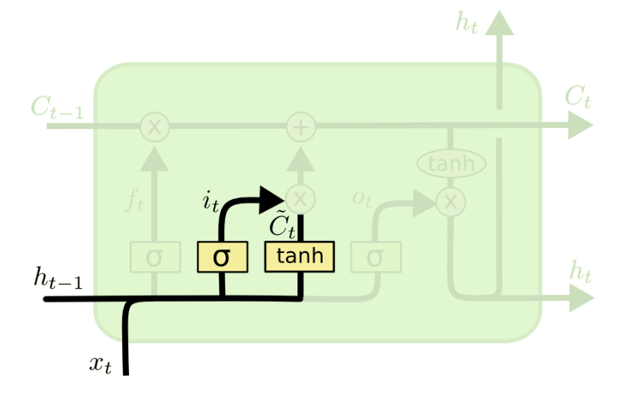
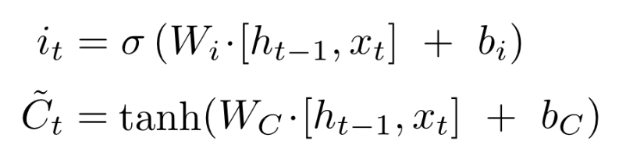

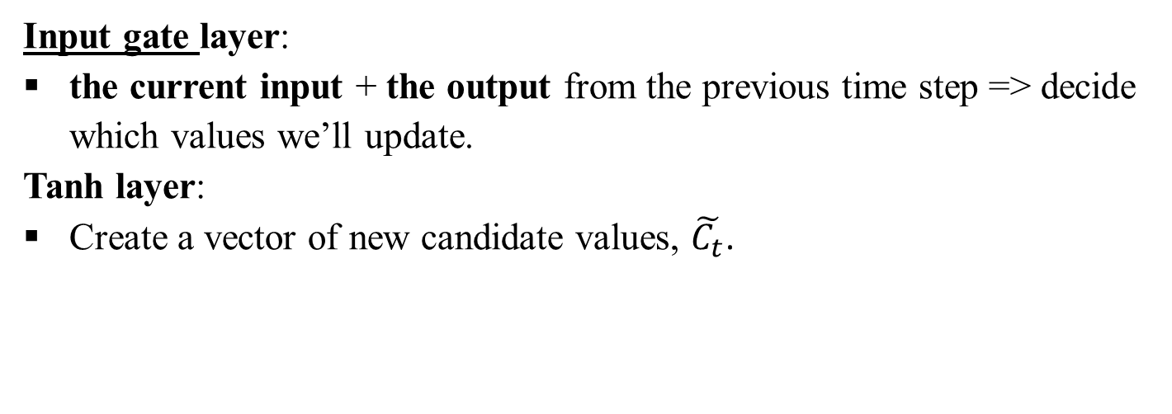
LSTM
Input gate layer:
the current input + the output from the previous time step => decide which values we’ll update.
Tanh layer:
Create a vector of new candidate values, $\tilde{C_{t}}$.
Step2

Slide 10


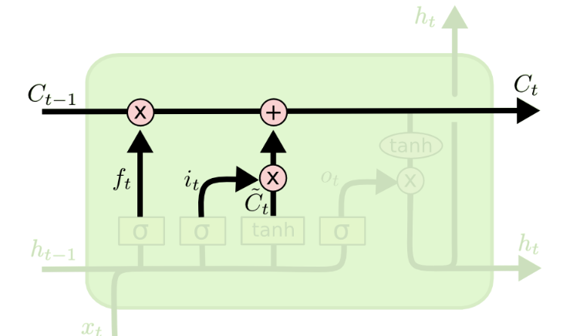
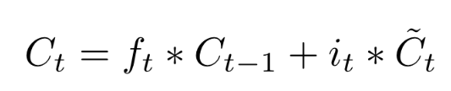
LSTM
Update cell state: Combine step 1&2
Forgetting the things we decide to forget earlier:
Adding information we decide to add:
Step3

Slide 11
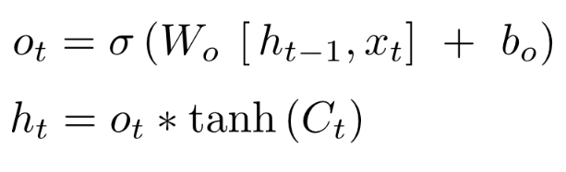
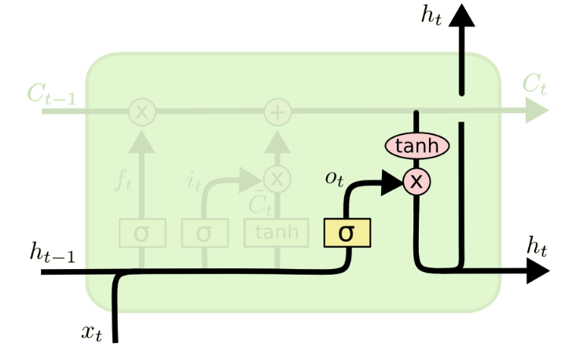
LSTM
Output gate layer:
Decide what parts of the cell state we’re going to output.
Tanh layer:
Push the values ranges from -1 to 1.
Step4
Hidden state/ Short memory

Slide 12
Conclusion
The LSTM design consists of three gates that control the flow of information:
The input gate regulates how much fresh information should be stored in the memory cell during the current time step.
The forget gate determines how much old information is discarded from the memory cell.
The output gate controls the quantity of information that is output from the memory cell at the current time step.
Tanh serves as a squashing function.
Sigmoid: serves as a decision function.

Slide 13
Advantages
Capturing long-term dependencies: LSTM models excel at capturing and remembering long-term dependencies in sequential data.
Handling vanishing/exploding gradients: LSTMs can mitigate the issue of gradients either diminishing or growing exponentially during training, enabling them to learn effectively from sequences of varying lengths.
Disadvantages
Computational complexity: LSTM models are computationally expensive compared to simpler RNNs. The additional components, such as gating mechanisms, increase the number of parameters and operations, resulting in longer training and inference times.
Need for large amounts of data: LSTM require a significant amount of labeled training data to generalize well. Insufficient data can lead to overfitting, where the model fails to generalize to unseen examples.

Slide 14
Thank you
for listening

